Slide 1

FINAL ASSESMENT- EXCEL
SHAKTIVEL R
4308

Slide 2
QUESTION 16 – INSIGHTS/ INFERENCE
Country and sum of views
The inference from the bar graph can be explained as the increasing trend of views by the country
That is views are more or less similar in all the countries from which we can infer than mostly the users are equally spreaded.

Slide 3
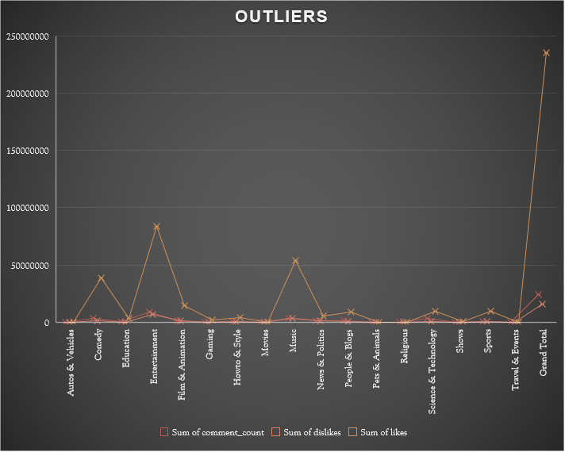
QUESTION 17 – INSIGHTS/ INFERENCE
Outliers in engagement metrics
The outliers in category are entertainment and music which shows many people are interested in listening to those in youtube

Slide 4
QUESTION 18– INSIGHTS/ INFERENCE
Trend of likes and dislikes
Sum of likes reaches its peak at the end of an year from which we could see that many users are arriving in the year end
There is no change in the trend of likes over the months from which we could under stand that likes and dislikes are not dependent on the viewers count on basis of months ,

Slide 5
QUESTION 19 – INSIGHTS/ INFERENCE
Trend for particular channel
From the graph we can conclude the viewing trend remains same for the specific cannel over the year

Slide 6
QUESTION 20 – INSIGHTS/ INFERENCE
Cohort analysis
In the cohort analysis given data ,
For this chart its simply indication of rise in trend in every quarter of every year but in due course we see a sudden drop in 2 nd quarter of 2018 which gives the alarming signal for company to scrutinize the problem in that time period because it’s a great drop after a great hike in view counts

